Slide 1
Deep Learning 2/3
Other considerations

Slide 2
Content
Recap Deep Learning, Neural Network workflow
Data:
Cleaning, Augmentation
Normalization, Splitting
Hyper-parameters
Batch, Epoch
Optimizer, Scheduler
Bias, Variance
Drop out, Batch Normalization
Regularization
Different architectures
Convolutional Neural Network (on cifar)

Slide 3

Recap
Define Model
Define forward()
Training
Inference
Loop over the dataset
Pipeline
Forward pass
Backward Propagation
Batch data
Batch data
Forward pass
get prediction
Forward pass
get prediction
Calculate loss
Use prediction
Calculate gradient
Update weights
Logging: loss value, epochs, time taken, etc
Use test data
Get metrics
Compare models
Save the state of the model

Slide 4
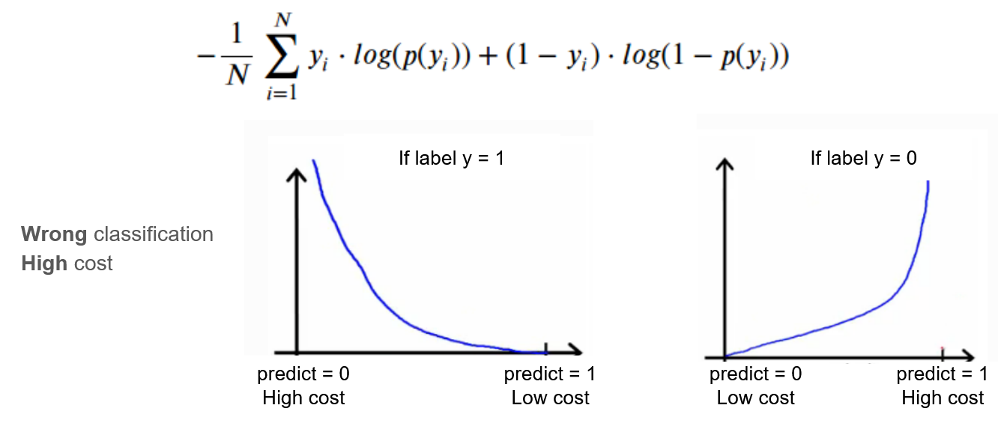
Recap: Loss Function
Loss function: Binary Cross Entropy

Slide 5
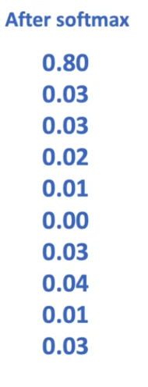
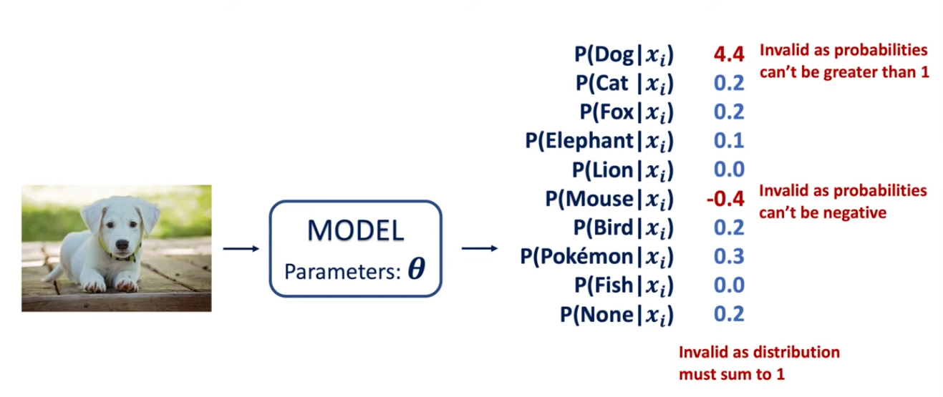
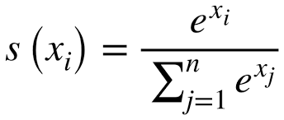
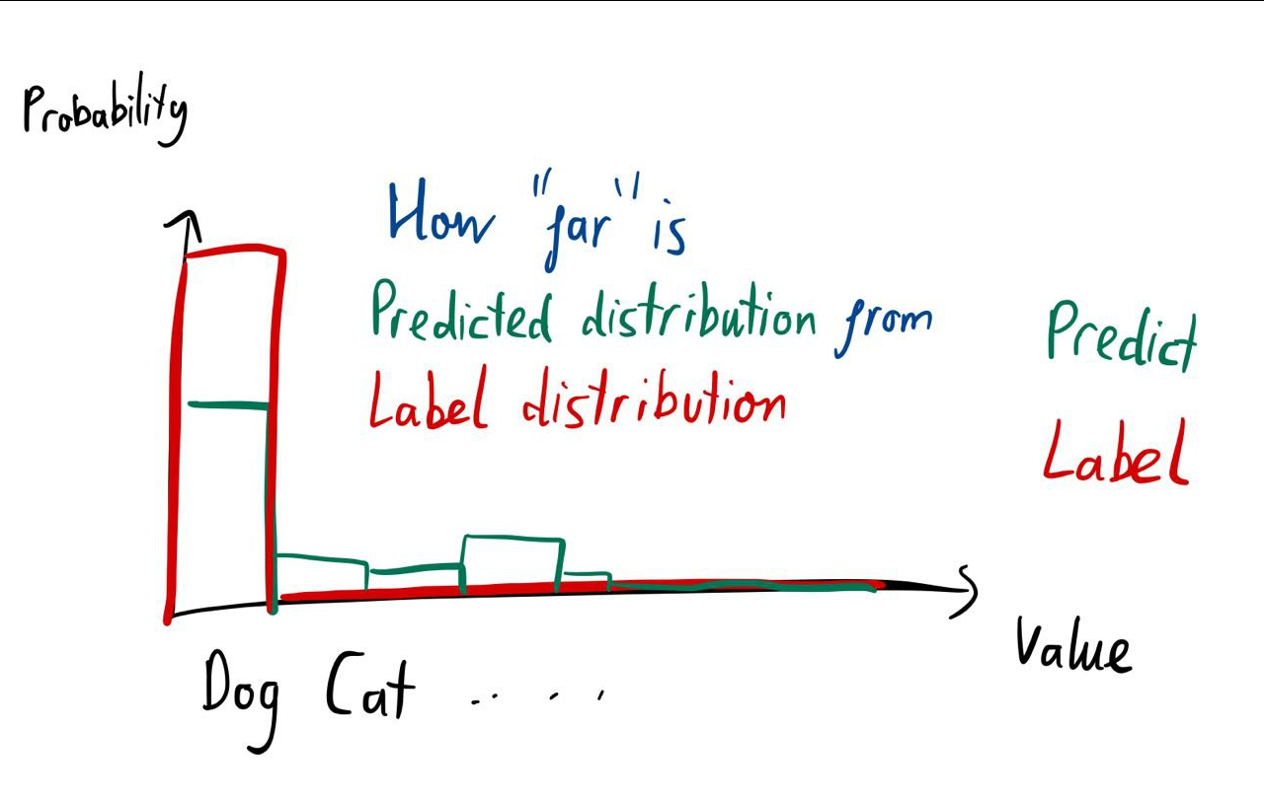
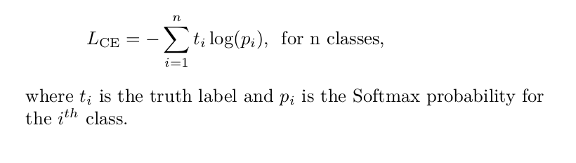
Softmax and Cross Entropy Loss
Softmax function
Cross Entropy Loss: https://www.youtube.com/watch?v=Pwgpl9mKars .KL Divergence: https://www.youtube.com/watch?v=SxGYPqCgJWM

Slide 6
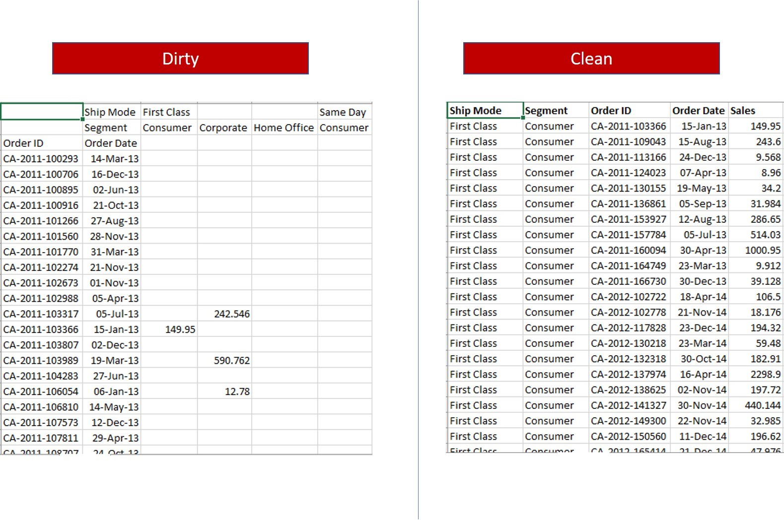
Introduction to Data Cleaning
Importance in Deep Learning: "Garbage in, garbage out."
Common issues: Missing values, outliers, inconsistencies.

Slide 7
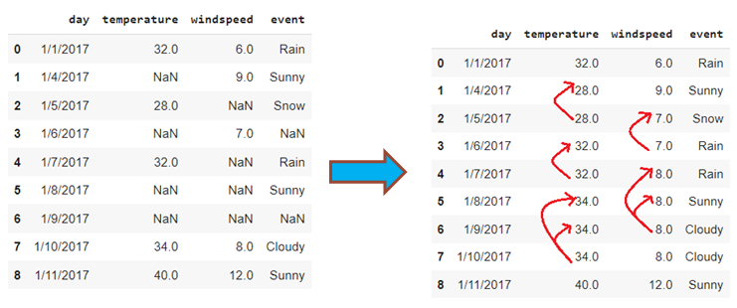
Handling Missing Data
Detection: Tools to detect missing data.
Methods: Imputation (mean, median, mode) vs. Deletion.

Slide 8
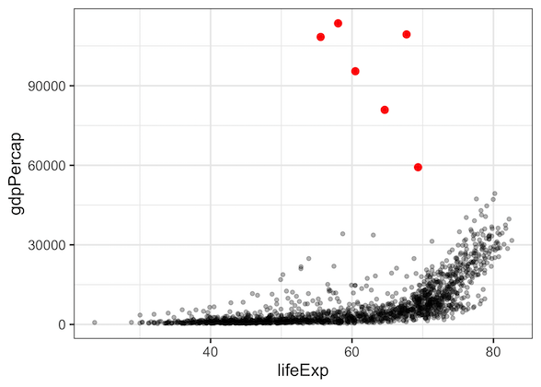
Removing Outliers
Problematic outliers: Skewing model predictions.
Z-score, IQR methods.

Slide 9
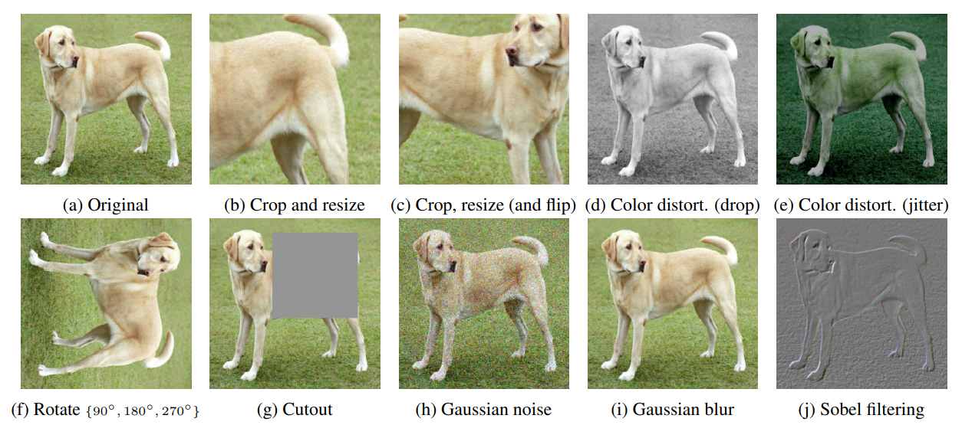
Why Data Augmentation?
Images of the same picture with different augmentations (rotation, size, etc).
Enhancing dataset size and diversity.
Prevents overfitting.

Slide 10
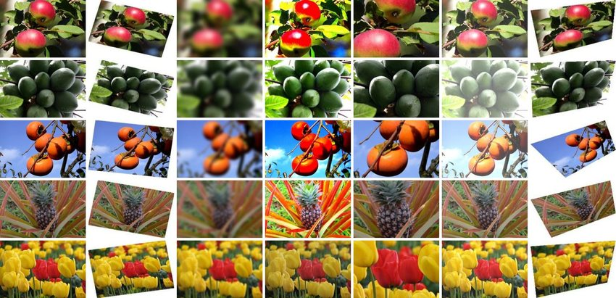
Common Augmentation Techniques
Image: Rotation, Flipping, cropping, adding noise, etc
Audio: Noise addition.
Text: Synonym replacement.
Augmentor
Imgaug
torchvision.transforms
https://pytorch.org/vision/0.9/transforms.html ; https://pytorch.org/vision/stable/transforms.html

Slide 11
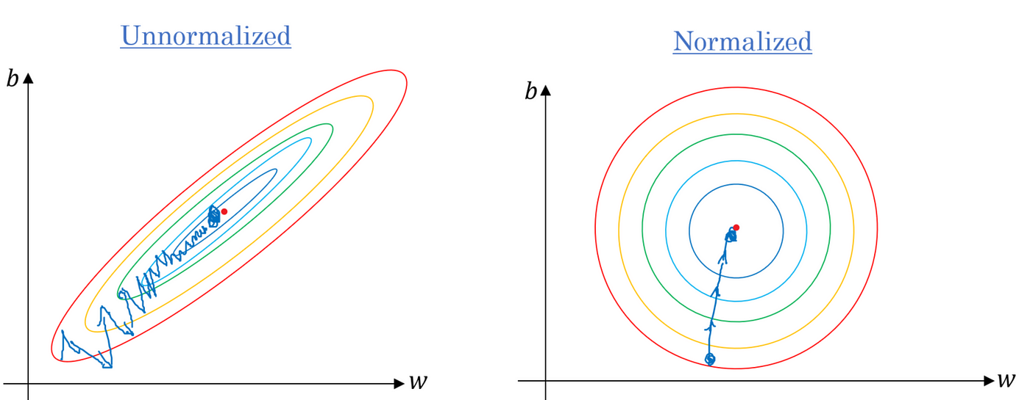
The Need for Normalization
Achieving faster convergence.
Equal importance to all features.
Especially useful when scales of features differ by large values
https://pytorch.org/vision/0.9/transforms.html ; https://pytorch.org/vision/stable/transforms.html

Slide 12
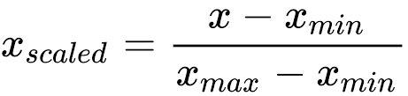
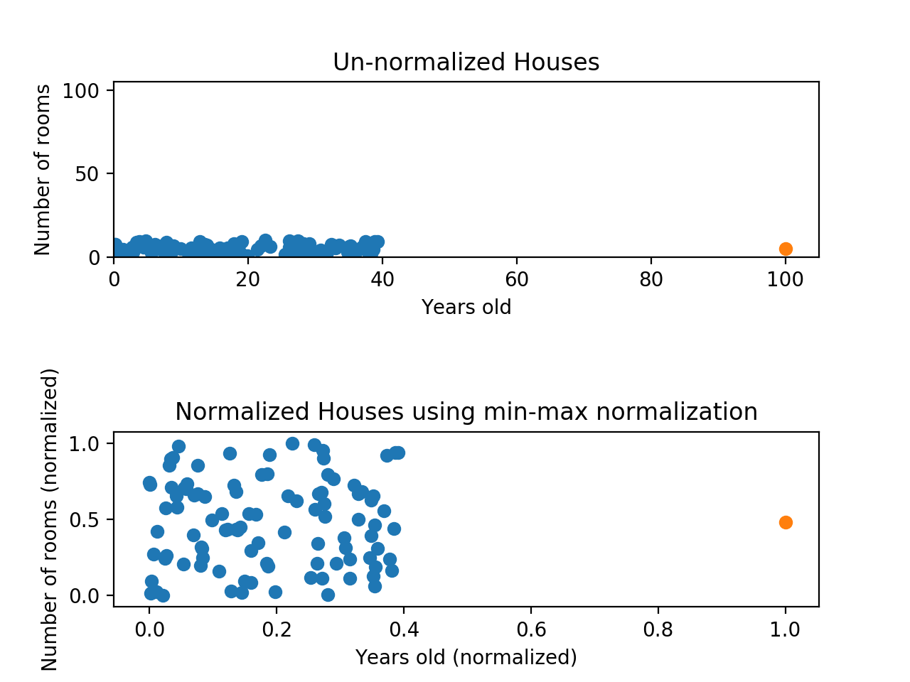
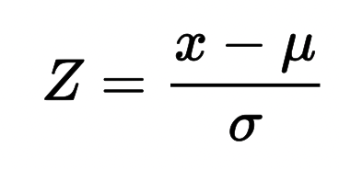
Normalization Techniques
Min-Max
Z-score
Batch normalization

Slide 13
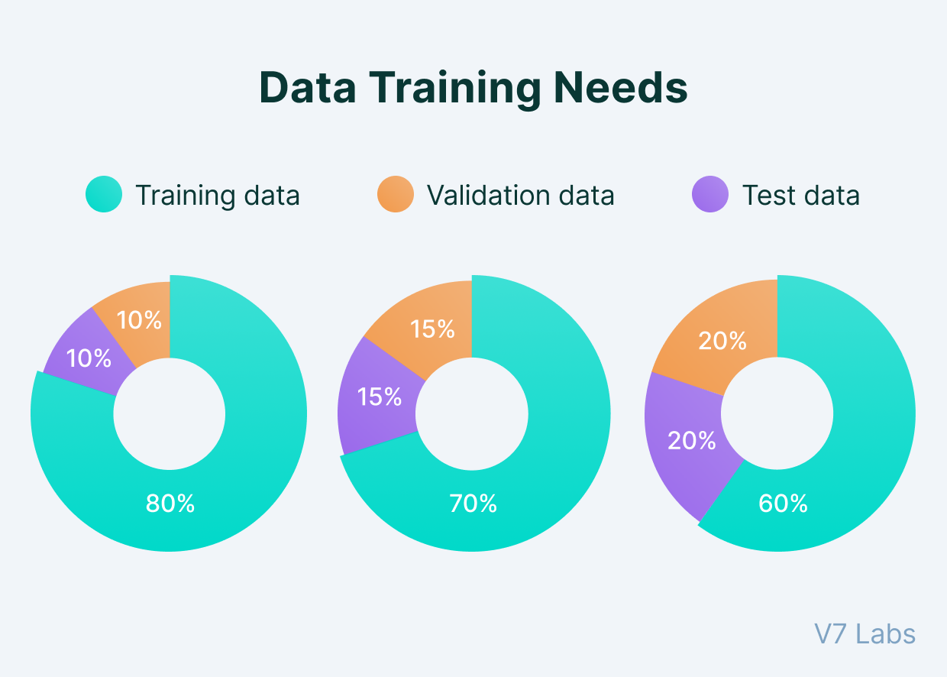
The Three Pillars of Data
Training Set: The data on which the model learns.
Validation Set: Used to fine-tune models, select hyperparameters.
Test Set: The final frontier; evaluating model performance.

Slide 14
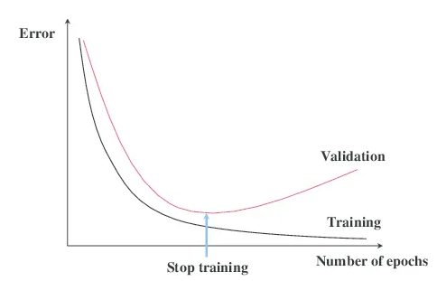
The Rationale Behind Three Splits
Loop over the dataset
Batch data
Preventing overfitting: Understanding its implications.
The need for a separate validation set: hyperparameter tuning without bias.
Test set: An unbiased performance metric.
Forward pass
get prediction
Calculate loss
Calculate gradient
Update weights
Test the current state of the model on validation
Logging: loss value, epochs, time taken, etc
Use test data
Get metrics
Compare models

Slide 15
The Rationale Behind Three Splits
Preventing overfitting: Understanding its implications.
The need for a separate validation set: hyperparameter tuning without bias.
Test set: An unbiased performance metric.

Slide 16
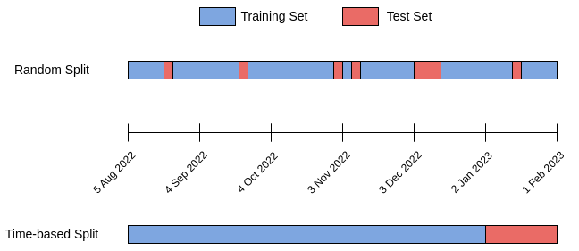
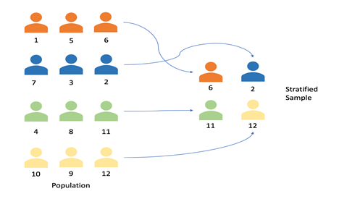
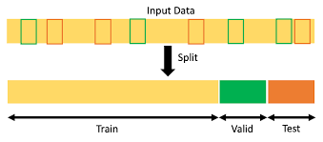
Techniques of Data Splitting
Random Split: Randomly dividing data.
Stratified Split: Maintaining class distribution across splits.
Time-based Split: Especially for time-series data.

Slide 17
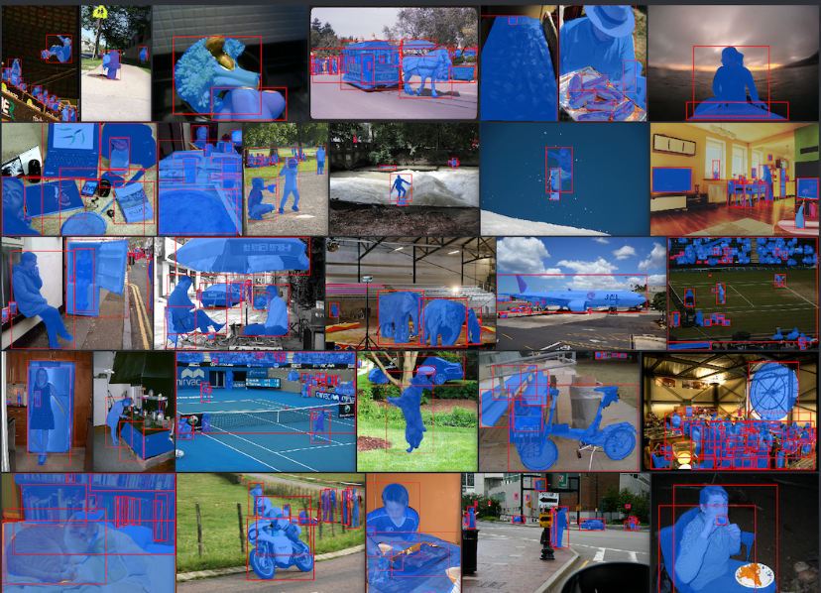
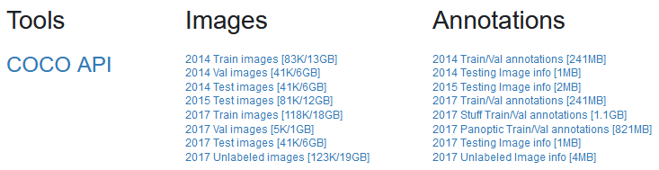
Example: COCO (Common Object in Context)
Image in .jpg with annotation in .json
https://cocodataset.org/

Slide 18
Hyperparameters: Batch, Epochs
Epoch: number of times you have loop through the data
Batch: number of data used in a weight update
Iteration per epochs = all data / batch

Slide 19
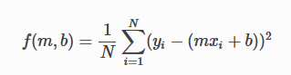
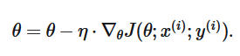
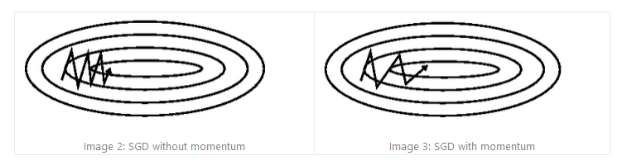
Optimizer
Update weights
Stochastic Gradient Descent (Batch, Minibatch)
Update using a batch instead of individual data points
N denotes the number of data points in a mini-batch
Adaptive Moment Estimate (Adam)
Use momentum
Converge faster
Learning Rate Scheduler
https://pytorch.org/docs/stable/optim.html; https://towardsdatascience.com/deep-learning-optimizers-436171c9e23f ; https://www.ruder.io/optimizing-gradient-descent/

Slide 20
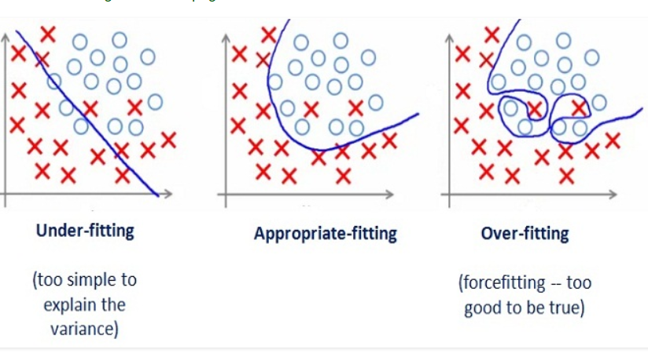
Bias and Variance
If the loss decreases over time, can’t we just let it run forever and get small loss?
Overfitting: High Bias, Low Training Loss, High Validation Loss
Underfitting: High Variance
https://medium.com/udacity-pytorch-challengers/trials-errors-and-trade-offs-in-my-deep-learning-model-d2e0c3d51794

Slide 21
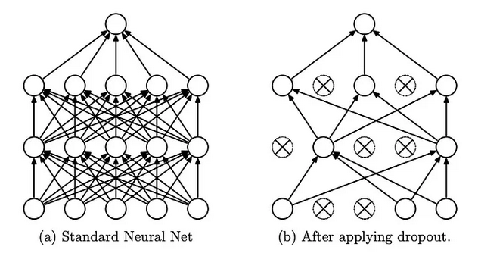
Dropout
https://pytorch.org/docs/stable/generated/torch.nn.Dropout.html

Slide 22
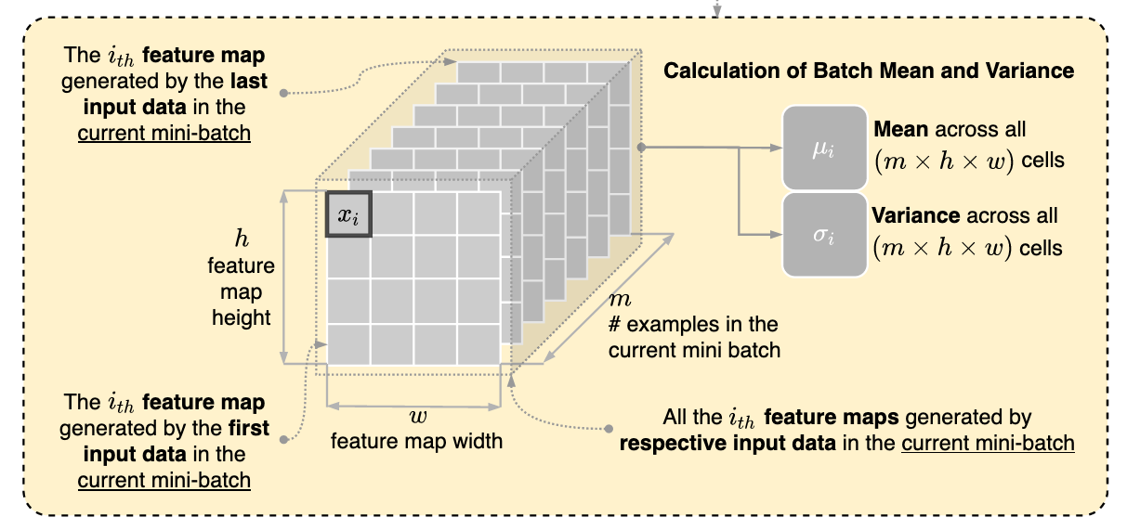
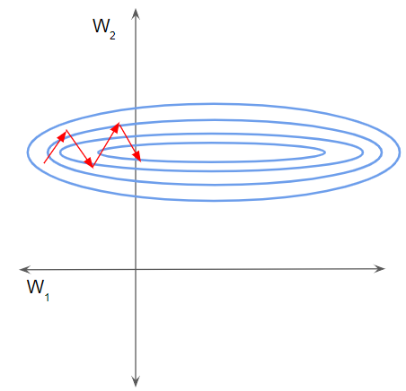
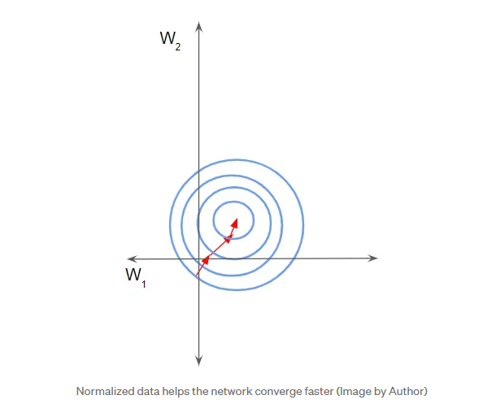
Batch Normalization
https://pytorch.org/docs/stable/generated/torch.nn.BatchNorm2d.html; https://towardsdatascience.com/batch-norm-explained-visually-how-it-works-and-why-neural-networks-need-it-b18919692739

Slide 23
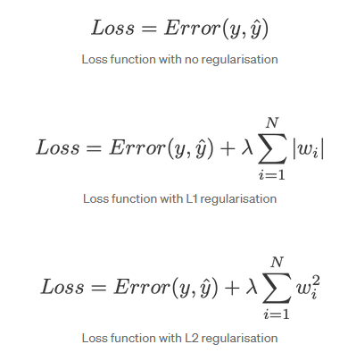
Regularization
Total Loss = CEloss + Regularization +
https://pytorch.org/docs/stable/optim.html; https://stackoverflow.com/questions/42704283/l1-l2-regularization-in-pytorch; https://towardsdatascience.com/intuitions-on-l1-and-l2-regularisation-235f2db4c261

Slide 24
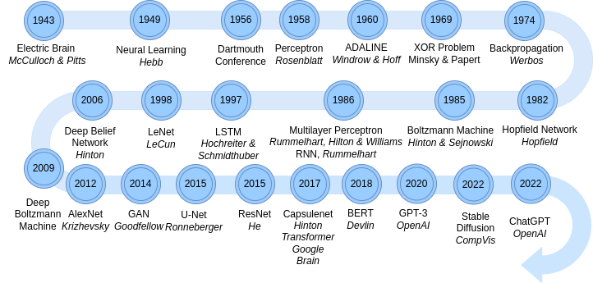
Exploring Neural Network Architectures
Understanding the evolution of architectures.
The role of architectures in defining model capability.

Slide 25
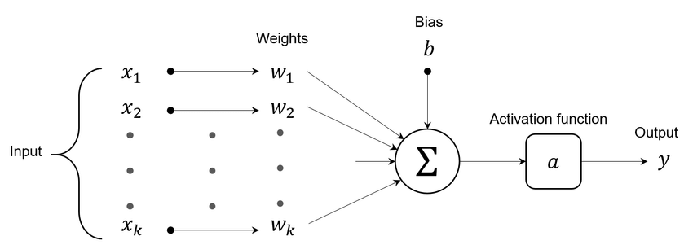
Linear Neural Networks
Basics of a linear layer: Weight, bias, and activation function.
Its simple and used in foundational models.

Slide 26
Introduction to Convolutional Neural Networks (CNNs)
Visualization of Convolution in Images: https://setosa.io/ev/image-kernels/
X,Y Sobel kernels are “handcrafted” by engineers
To detect horizontal, vertical edges
What about detection of complex things?
CNN weights are the values of the kernel pixels
Randomly initialized
Loss function calculated the difference between the prediction and the label
Weights (kernel pixels) are adjusted to make detection better
https://poloclub.github.io/cnn-explainer/
https://cs231n.github.io/convolutional-networks/

Slide 27


Slide 28
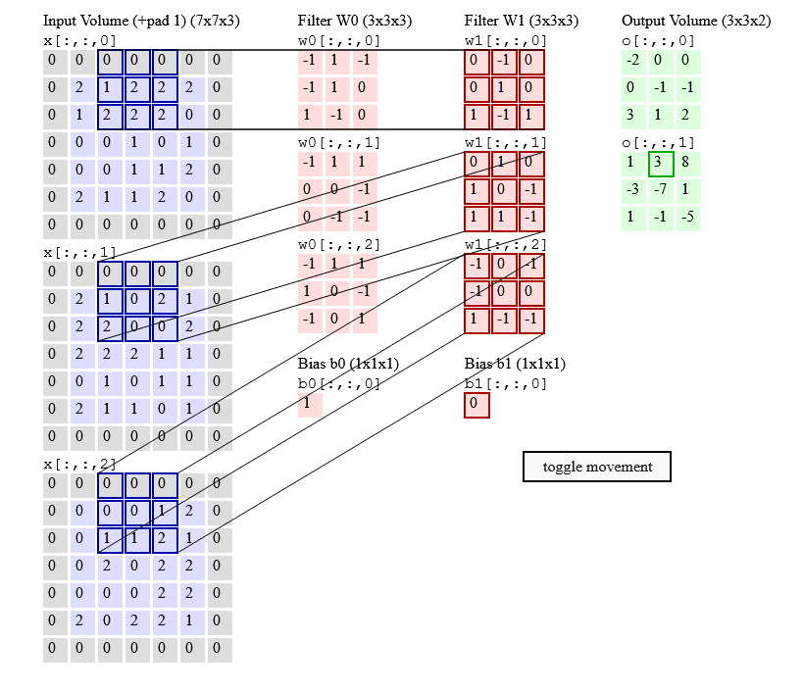

Convolutional
Neural
Network
Why only 3 RGB channel but you can have so many filters?

Slide 29
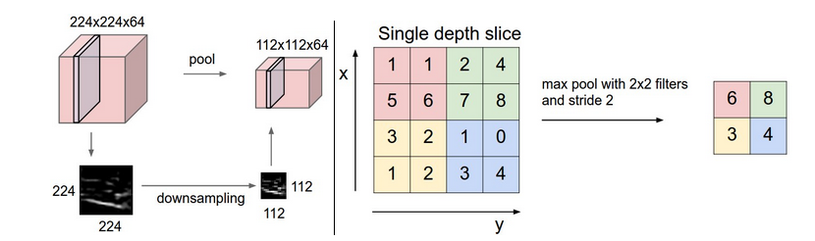
Convolutional Neural Network
Pooling

Slide 30
Google Colab

Slide 31
Different architecture (for inspiration only, not today)

Slide 32
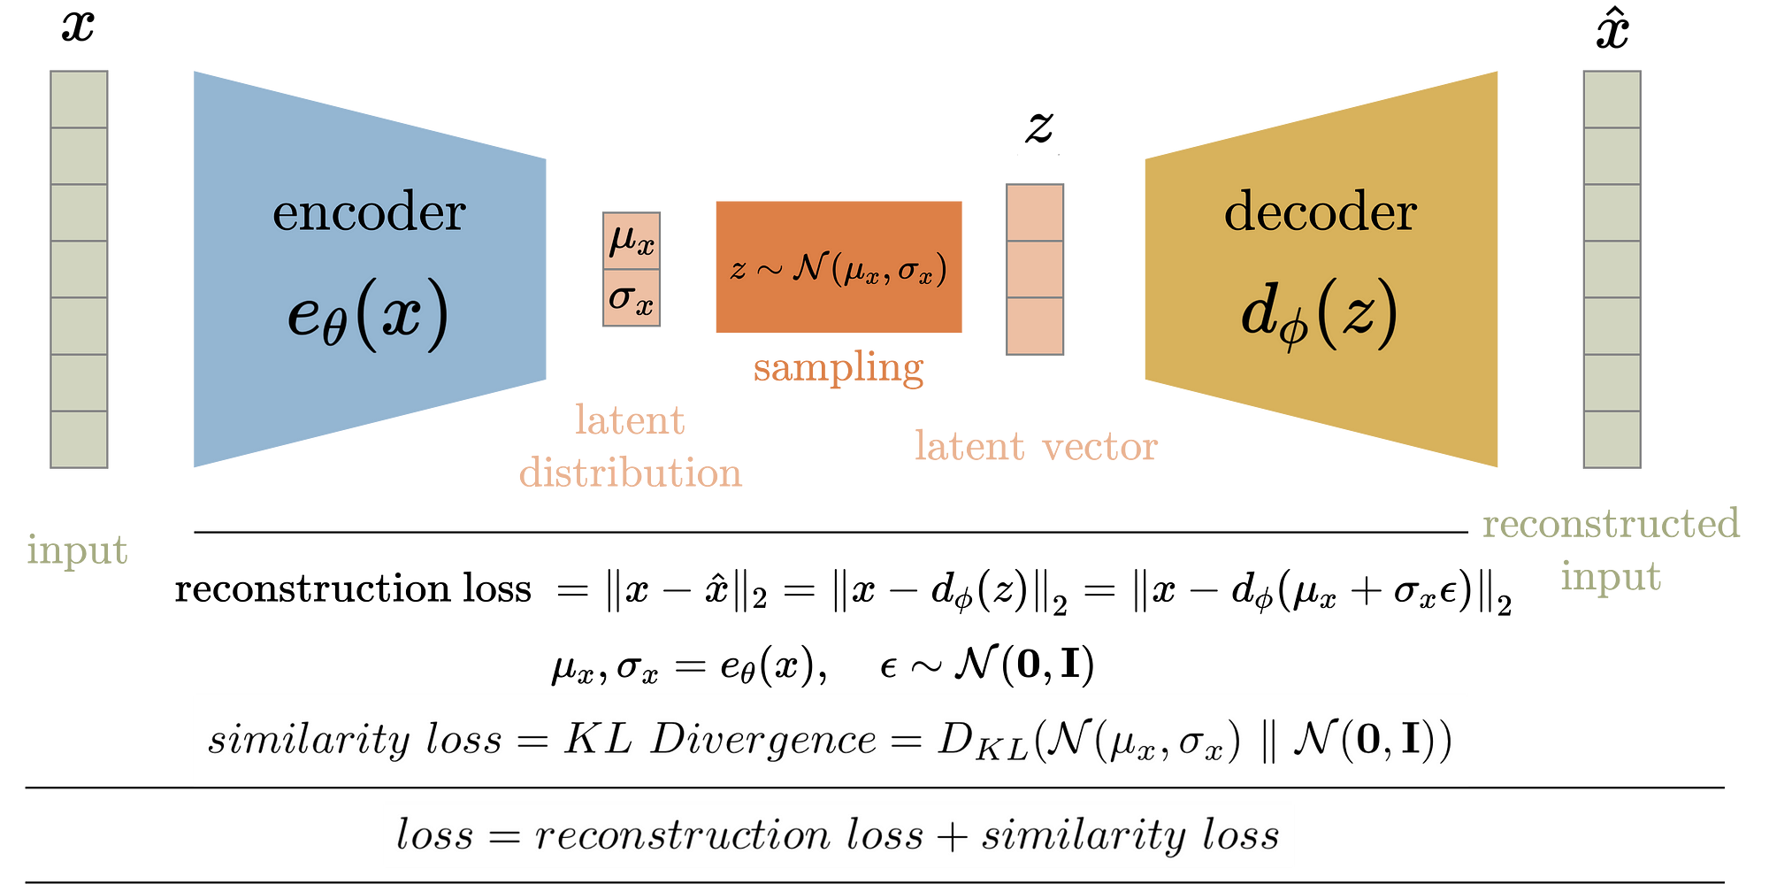
Variable Autoencoder (VAE)

Slide 33
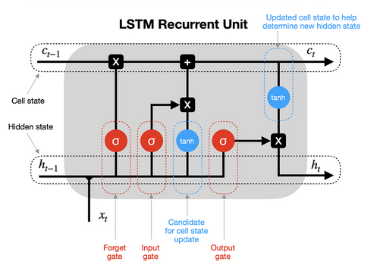
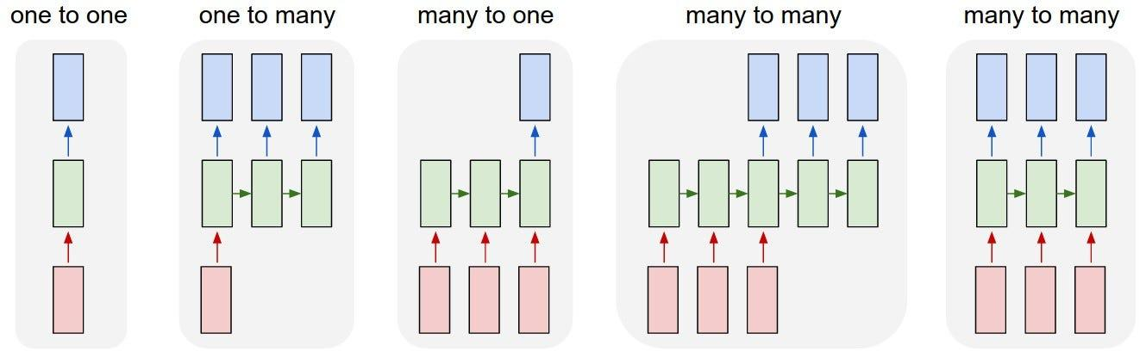
Long Short Term Memory

Slide 34

UNet

